Slide 1
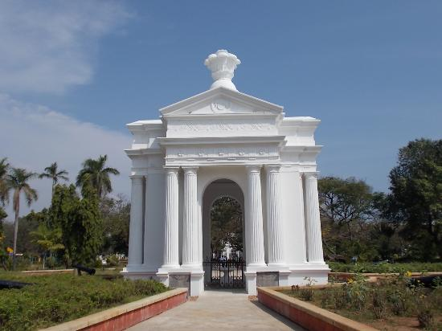
GOVERNMENT OF PUDUCHERRY
MID-DAY MEAL SCHEME 2019-20

Slide 2
U.T of Puducherry
Action Taken for the year 2018-19
Best Practices of UT
Budget Proposal 2019-20

Slide 3
Action Taken on 2018-19
Less coverage of children in Karaikal in Upper Primary (68%) level under MDMS Karaikal region | To improve the coverage under MDMS variety menus have been introduced.
Utilization of MME is very low (6%) | Specified Action Plan prepared accordingly ,Expenditure will be incurred
Social Audit under MDMS yet to be conducted | Social Audit will be conducted in 2019-20
On 20th April 2018,out of 416 schools, only 272 schools reported on AMS portal | Necessary instructions has been given to the inspecting officers to ensure 100% data entry
Mismatch in data of AWP&B and MDM –MIS on engagement and payment of honorarium to Cook cum helpers. | Data has been rectified

Slide 4
PROGRESS FOR THE YEAR 2018-19
LEVEL | STANDARD | STUDENTS STRENGTH | PAB APPROVAL 2018-19 | MDM BENEFICIARIES 2019-20 | Percentage
Primary | I to V | 31621 | 26231 | 25875 | 98%
Upper Primary | VI to VIII | 24895 | 19252 | 18715 | 97%
Total |  | 56516 | 45466 | 44590 | 98%
Total no. of schools =429/431

Slide 5
MDM Beneficiaries for the year 2018-19=44590 MDM Beneficiaries for the year 2017-18=45466 =(-876)
PROGRESS FOR THE YEAR 2018-19
LEVEL | STANDARD | No.of Beneficiaries PAB APPROVAL 2018-19 | STUDENTS STRENGTH | MDM BENEFICIARIES
Primary | I to V | 26231 | 31621 | 25875
Upper Primary | VI to VIII | 19235 | 24895 | 18715
Pre-Primary | LKG & UKG |  | 8061 | 6779
High School & HSS | IX TO XII STD |  | 30812 | 18604
Total |  | 45466 | 95389 | 69973

Slide 6
STANDARD MENU
MONDAY | Rice, Mixed Vegetable Sambar, Potato Poriyal & Egg
TUESDAY | Variety Rice – Tomato Rice with Potato and Carrot Poriyal
WEDNESDAY | Rice, Mixed Vegetable Sambar, Beetroot Poriyal & Egg
THURSDAY | Variety Rice – Tamarind Rice with Potato Poriyal
FRIDAY | Rice, Mixed Vegetable Sambar, Raw Banana Poriyal
Sambar : Dhall with mixed vegetables like Brinjal, Ladies Finger ,Beans, Drumstick and Cabbage,Chow Chow, Knol Khol, Carrot based on the availability:
Black channa/Mochai provided on Non Egg days

Slide 7
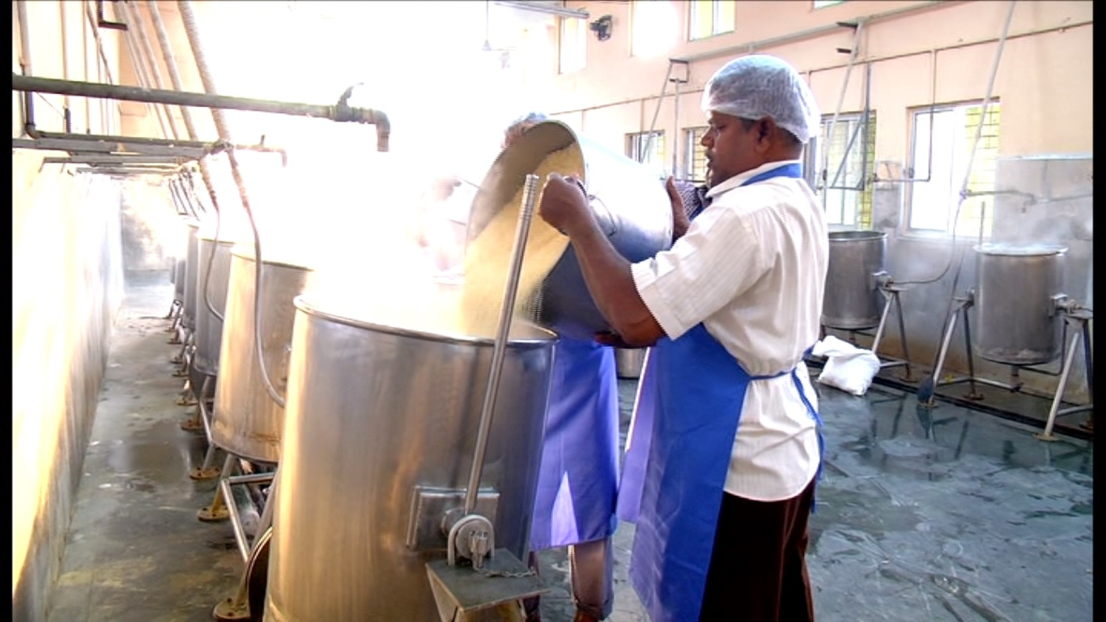
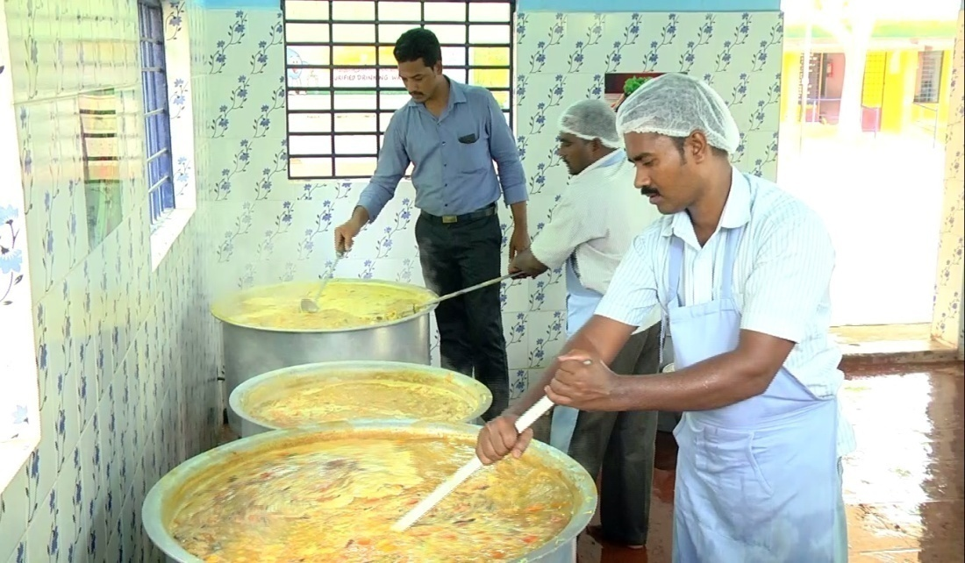
Cooking Process in central kitchen
in cluster kitchen

Slide 8
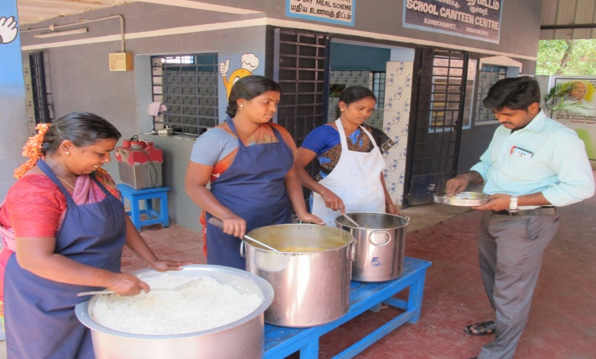
Teacher tasting the food before serving

Slide 9
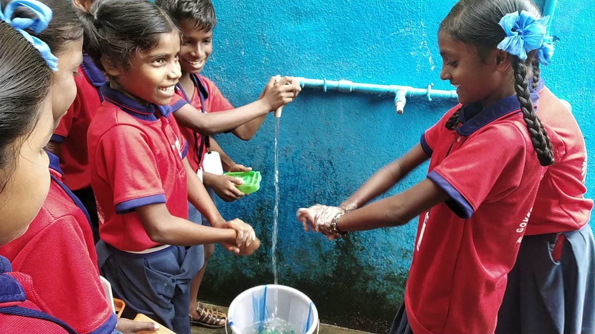
HAND WASH

Slide 10
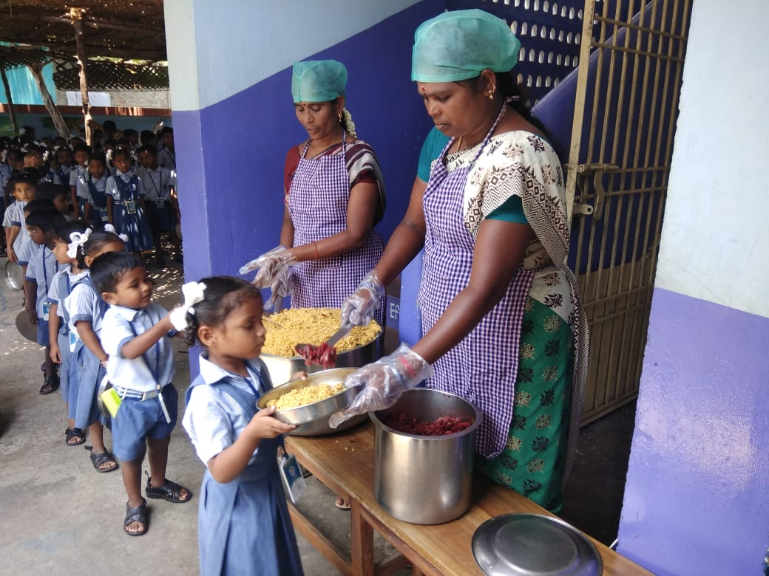
MIDDAY MEAL SERVED TO THE STUDENTS

Slide 11
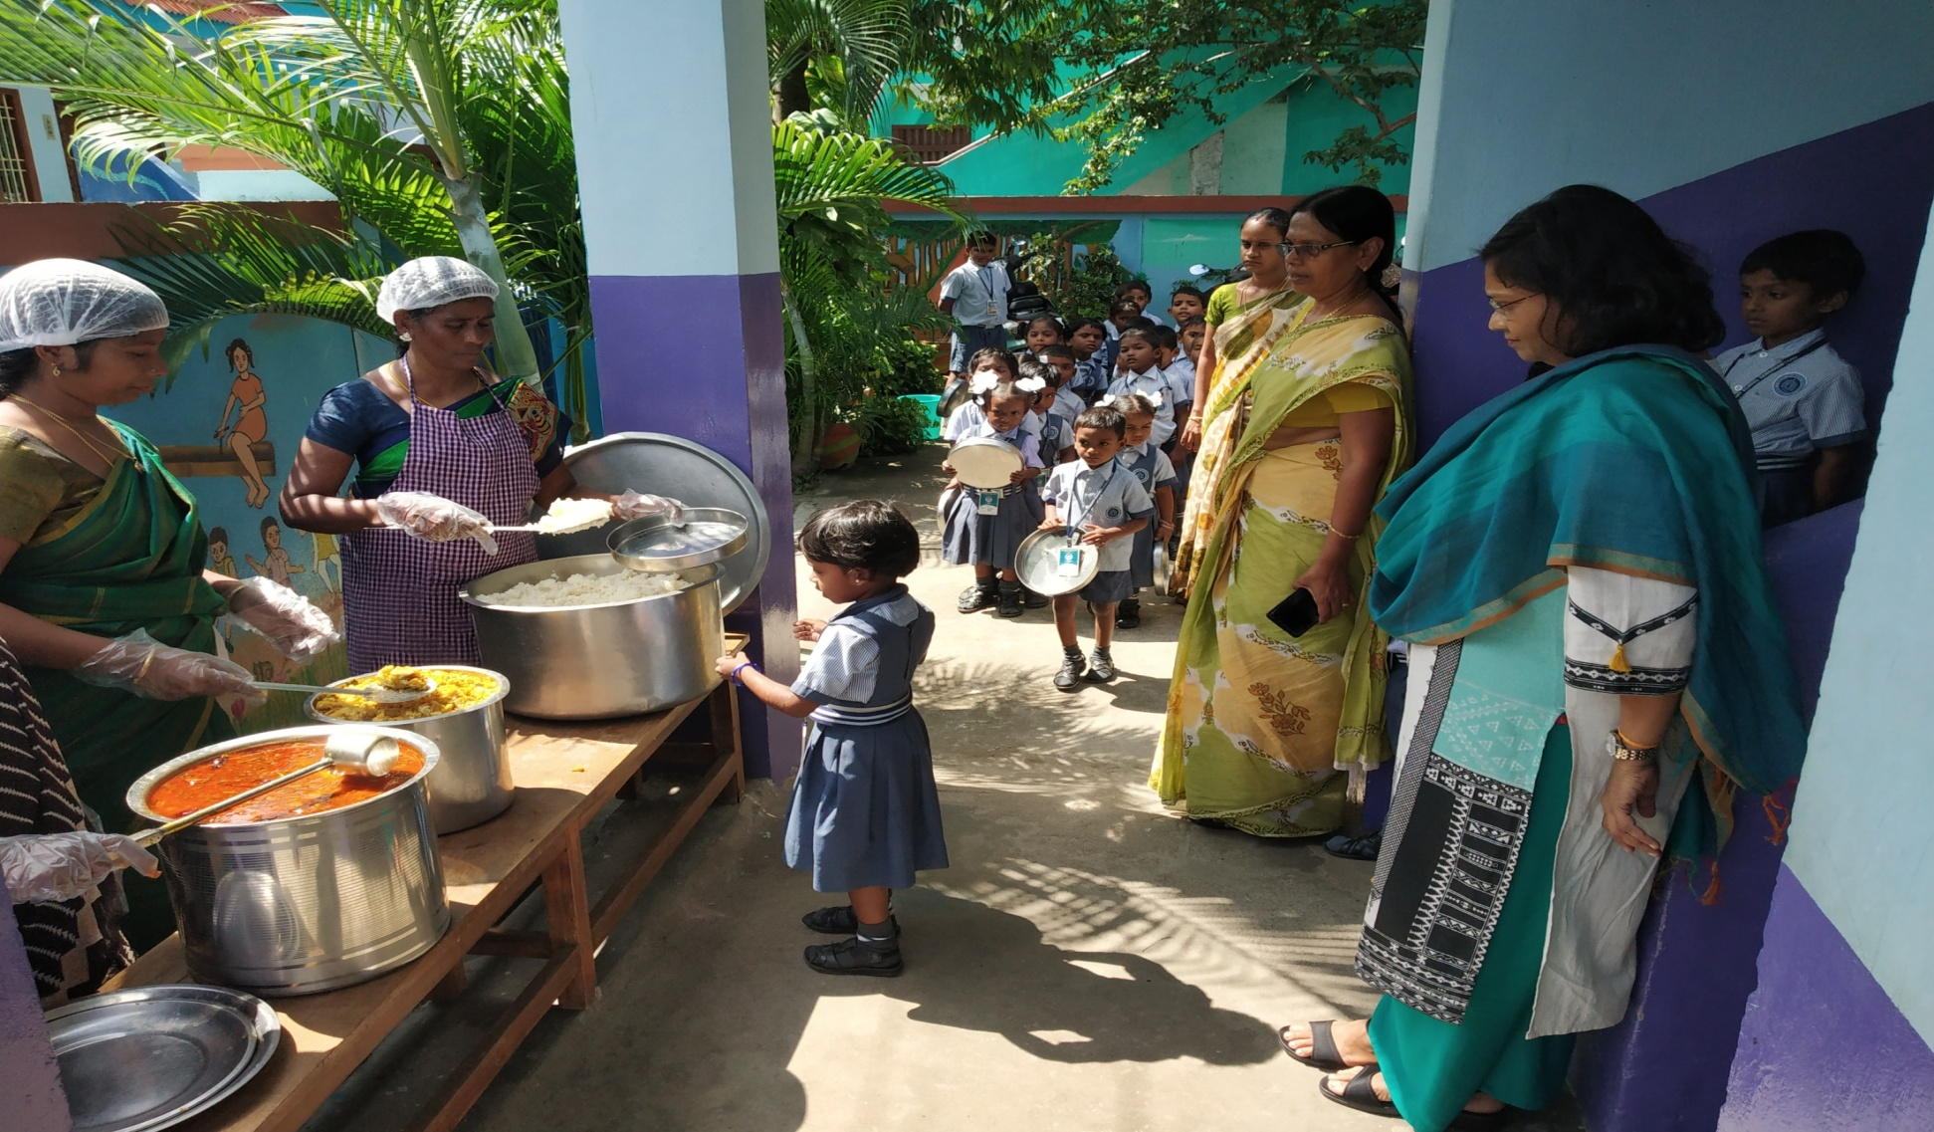
Official Visit by MHRD

Slide 12
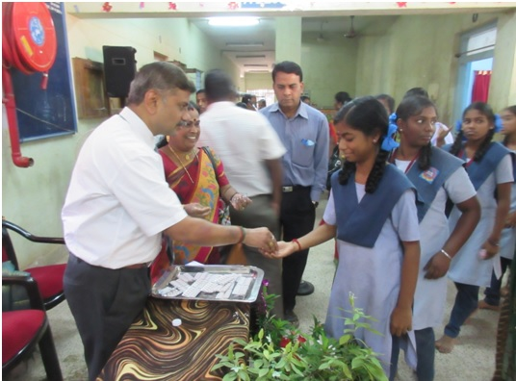
HEALTH PROGRAMME
DISTIRIBUTION OF ALBENDAZOLE TABLET

Slide 13
SCHOOL HEALTH PROGRAM 2018-19
Total No. of Schools covered – 429
Distribution of Iron & Folic Acid, Vitamin A & De-worming Tablets
Distribution of Spectacles – 242 Students

Slide 14
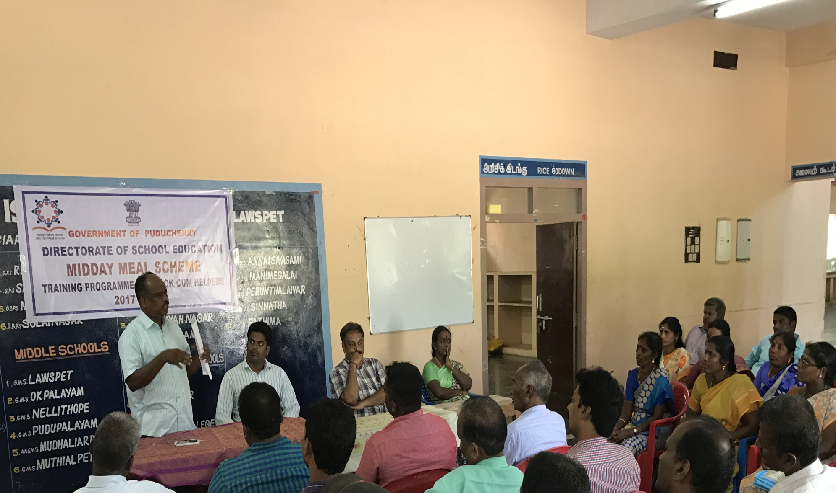
TRAINING PROGRAMME TO COOK CUM HELPER
*Periodical Health Checkup to Cook cum Helpers

Slide 15
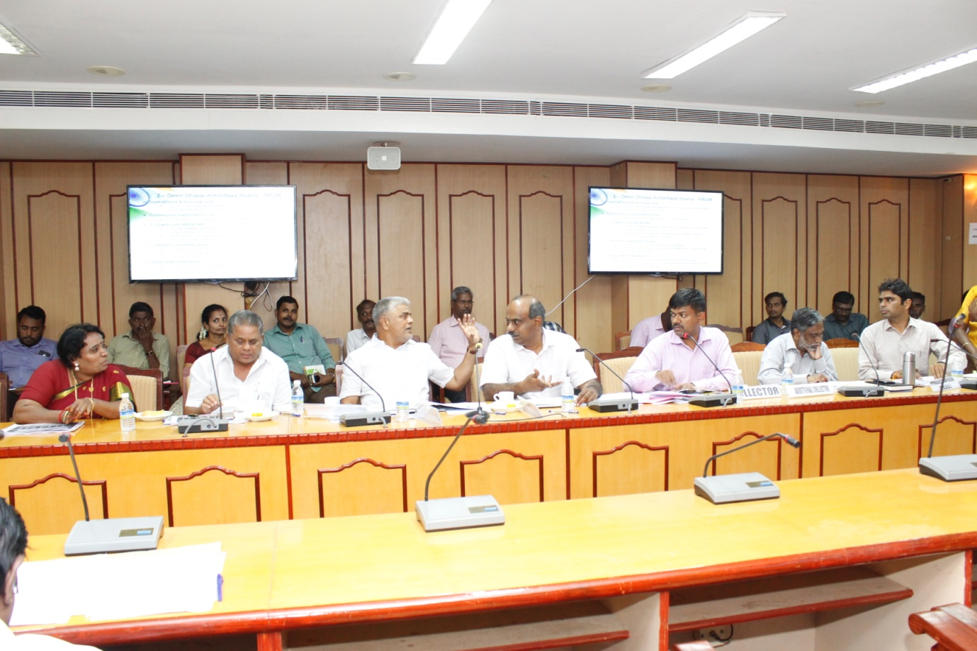
District Level Committee Meeting - Karaikal
Hon’ble M.P (Lok Sabha) Chairperson, Education Minister ,District Collector, & other officials , meeting held on 28.02.2019

Slide 16
Expenditure – 2018-19
Rs. in lakhs
NUTRITION Mid Day Meal | Allocation | Opening balance | Released | Total | Expenditure as on 31.03.2019 | Percentage
Central 60% | 519.93 | 0.00 | 534.32 | 534.32 | 396.23 | 75%
State-40% | 236.65 | 0.00 | 236.65 | 236.65 | 236.65 | 100%
Additional U.T fund | 1092.1 | 0 | 1092.1 | 1092.1 | 1092.1 | 100%

Slide 17
Best Practices:-
Covers Pre-Primary & XI & XII std students which are not covered under Central Schemes
Break Fast scheme 100ml of Hot milk to the students – Rs.1185.33 lakhs under State fund.
Food is prepared in modernized central kitchens and cluster kitchens in a hygienic atmosphere.
Egg is provided to students twice a week amount Rs.200 lakhs(U.T Fund)
Safe drinking water with RO Systems
All central kitchens and cluster kitchens use LPG
Procurement of Agmark diet articles through Co-operative institutions / Govt. undertakings by limited tender system

Slide 18
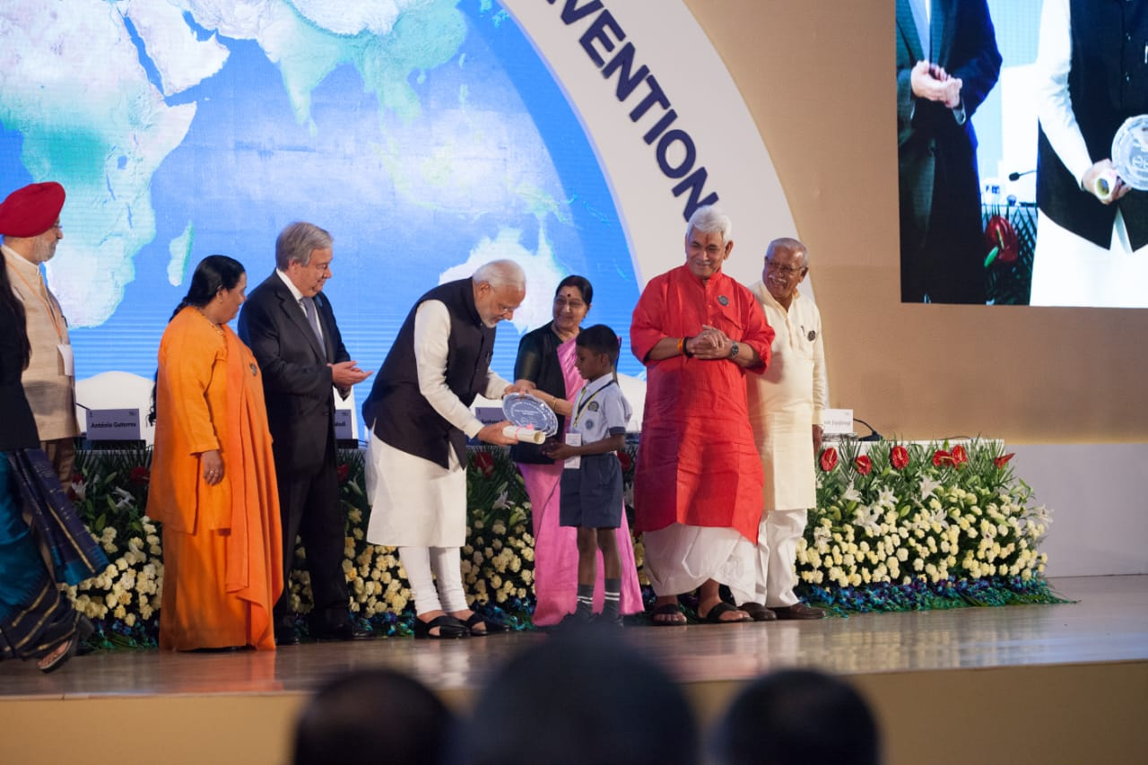
National level competition writing letter to Prime Minister
National Award for Government student
by Hon’ble Prime Minister

Slide 19
Shri Rajiv Gandhi Breakfast scheme 2018-19
Region | Total No. of Beneficiaries | Cost of 100 ml / per student In Rs.
Puducherry | 37340 | 7.30
Karaikal | 13500 | 7.08
Mahe | 2950 | 6.95
Yanam | 4000 | 6.95
Total | 57790
OUTLAY -2018-19 Rs. 1185.33 lakhs

Slide 20
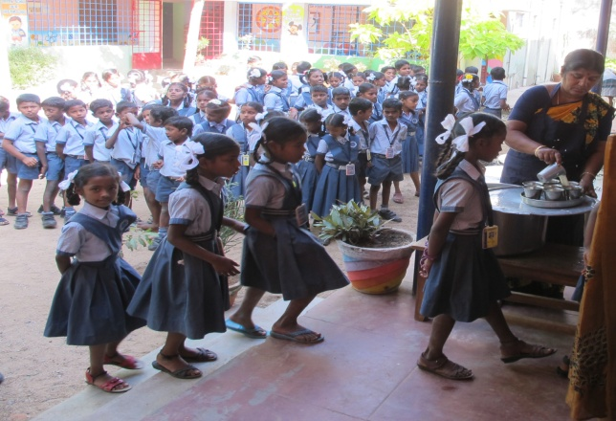
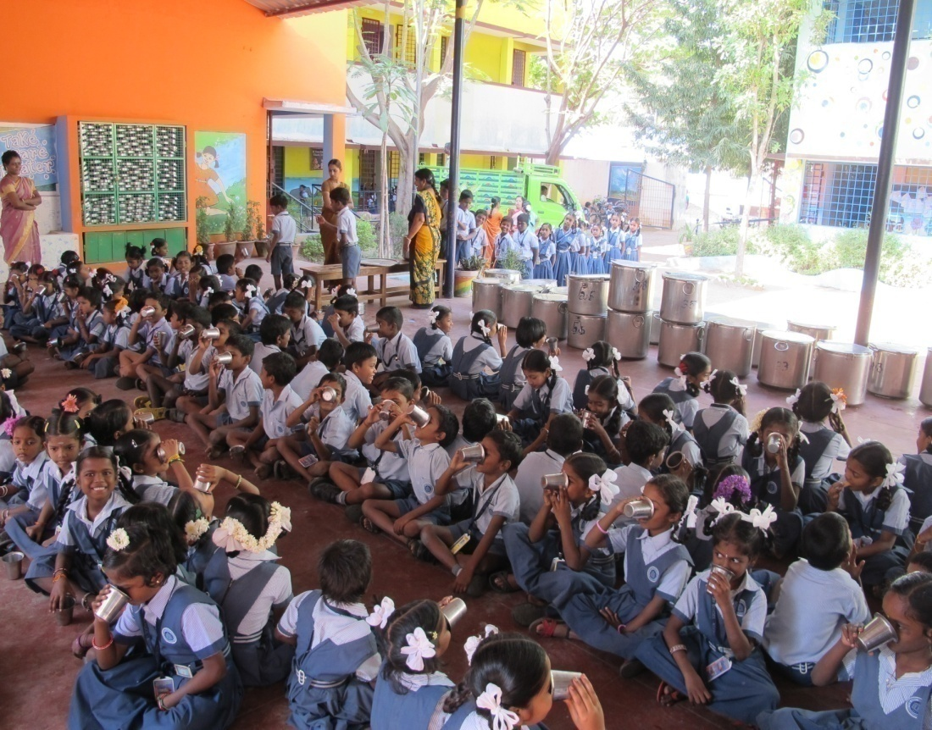
PROVIDING HOT MILK

Slide 21
BUDGET PROPOSAL 2019-20

Slide 22
FINANCIAL PROGRESS-2019-20
(in lakhs)
COMPONENT | PAB APPROVAL 2018-19 | PROPOSAL 2019-20
Recurring | 519.93 | 540.59
Non Recurring | - | -
Total | 519.93 | 540.59

Slide 23
COMPONENT WISE PROPOSAL 2019-20
Component | Primary |  | Upper Primary | Total ( Rs in lakhs)
Recurring Assistance
Cost of Food grains |  | 16.38 | 18.81 | 35.19
Cooking Cost (vegetables, pulses, other condiments and Fuel) |  | 142.50 | 163.44 | 305.94
Honorarium to Cook-cum-Helper 1031 CCH @ Rs.600 for 10 months |  | 33.36 | 28.50 | 61.86
Transportation Assistance |  | 8.19 | 9.41 | 17.60
Management Monitoring Evaluation-MME |  | 120.00 | 0.00 | 120.00
Total - A |  | 320.43 | 220.16 | 540.59
Non Recurring Assistance
Kitchen-cum-Store |  | 0 | 0 | 0
Kitchen Devices |  | 0 | 0 | 0
Total -B |  | 0 | 0 | 0
Grand Total - A+B |  | 320.43 | 220.16 | 540.59

Slide 24
BUDGET PROPOSAL 2019-20
( in lakh)
Component | Central Assistance-60% |  |  | State 40%(Manadatory) |  |  | Grand Total
 | Primary | Upper Primary | Total | Primary | Upper Primary | Total
Cost of Food grains | 16.38 | 18.81 | 35.19 |  |  | 0.00 | 35.19
Cooking Cost | 142.51 | 163.44 | 305.94 | 95.00 | 108.68 | 203.68 | 509.63
Honorarium to Cook-cum-Helper | 33.36 | 28.50 | 61.86 | 22.24 | 19.00 | 41.24 | 103.10
Transportation Assistance | 8.19 | 9.41 | 17.60 |  |  | 0.00 | 17.60
MME | 120.00 | 0.00 | 120.00 |  |  | 0.00 | 120.00
Total - A | 320.44 | 220.15 | 540.59 | 117.24 | 127.68 | 244.92 | 785.51

Slide 25
ACTION PLAN-2019-20
Completion of Kitchen cum stores
Planning to develop kitchen Gardens in Schools.
Cooking Competition among the Cook cum helpers
Conducting Social Audit by professional Agency

Slide 26
T H A N K Y O U

